Slide 1

DOT NET ARCHITECTURE
(OR)
DOT NET FRAME WORK ARCHITECTURE
PROF. S. LAKSHMANAN,
DEPT. OF B. VOC. (SD & SA),
ST. JOSEPH'S COLLEGE.

Slide 2
DOT NET ARCHITECTURE (OR) .NET FRAME WORK ARCHITECTURE
.NET
It is a programming structure it is used for building ,deploying & doing other services
Application can share data across multiple plat form and other programming language
Many third party wander and also take for .NET

Slide 3
C# | VB | C++ | JSCRIPT | J#
CLS(Common Language System)
Asp. Net Web Forms Web Service |  | Console Application Windows Application
ADO. Net & XML
Class Library
CLR(Common Language Runtime)
Operating System
.NET

Slide 4
COMMON LANGUAGE RUNTIME
the common language runtime is part of .NET frame work.
It creates run time environment of .NET
the code & provides services also mange resource such as Garbage collection & memory management
Major Components Of CLR
CTS-Common Type System
CLS-Common Language System
CIL-Common Intermediate Language
JIT-Just In time Compiler
VES- Virtual Education System

Slide 5
CTS(Common Type System)
It is implemented by CLR to specify How Object are specified
the main idea of .NET is to Support Multiple language
CTS define a single Consistent type System that .NET language use following list of types that is specified by CLR
CLASS
it includes method, Events & properties
INTERFACES
Definition of function in the class without any code
VALID TYPE
user defined data type which are passed by valued
DELYCASE
Used for Event Handling & Call Back

Slide 6
CLS(COMMON LANGUAGE SYSTEM)
set of language featured Supported by CLS.
It is subset of CTS using CLS only we can achieve the crass language interoperability
Example
Component developed in VB can be used in C# for doing this it spin by some roles.

Slide 7
CIL(COMMON INTERMEDIATE LANGUAGE)
it is also called Microsoft intermediate or Just intermediate.
It is language independent code when a source code with any compile with generate CIL
.NET Support two kinds of coding
Manage code
Unmanaged code
Mange code
this is code developed in .NET frame work
This code directly executed by CLR
Source code
Native Compiler
MSIL
Code
Executable
code
JIT
CPU
O/p

Slide 8
CIL(COMMON INTERMEDIATE LANGUAGE)
Unmanaged code
the code which is developed out side .NET frame work
This are the application that do not run under the control are CLR
Example: VB,Asp,C++
It is executed with the help of wrapper class
Two type of wrapper class
Form com callable wrapper class(CCW)
Run time callable wrapper class(RCW)
Native code(Executable code)
Code to be executed must be converted into
a language that target organization system.
Source code
CCW
Native Compiler
MSIL
Code
RCW
JIT
Executable
code
CPU
O/p

Slide 9
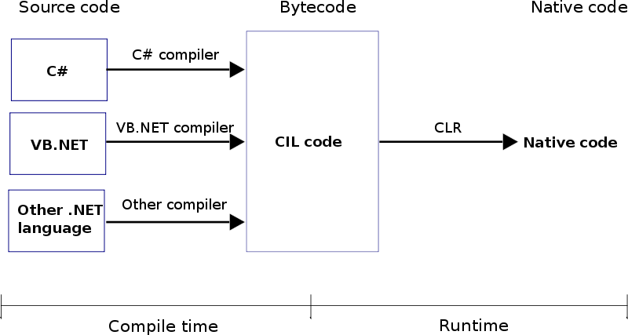

Slide 10
JIT JUST IN TIME COMPILER
It compiler MSIL into native code that specific to Os ,that architecture
MSIL code is compile only generic needed
JIT uses as MSIL code which is independent of the machine Os as CPU
three type JIT
Free JIT
Econo JIT -> choose Callable specified executable code
Normal JIT -> cache code
VES(Virtual Education System)
It is load, link executed written for CLR
Provides for CLR automatic memory allocation,debuging support & interoperability unmanaged code

Slide 11
CLASS LIBRARY
It consist of more then 2500 classes feature of this class are available for all language
It provides a common language set of base class library so that any language can using.
Base class library includes Network,Security,I/O operation other Os Related services
This class are organize with in a hierarchy called Namespace.

Slide 12
Namespace
Namespace is a simple way to group variable, functions, and classes
under the common name it also give scope for the class root of hierarchy of system namespace and all the base class are under.
Example
1.System.Data;
Contains basic database Management types.
2.System.IO;
It manages Input/Output operations
3.System.Net;
Used for Network communication

Slide 13
Thank You.

